Slide 1
Inheritance
Course Code: CSC1205
Course Title: Object Oriented Programming -1(JAVA)
Dept. of Computer Science
Faculty of Science and Technology
Lecturer No: | 5 | Week No: | 5 | Semester: | Summer 21-22
Lecturer: | Mazid-Ul-Haque, mazid@aiub.edu

Slide 2
Lecture Outline
Inheritance definition and example
Different types of Inheritance
Constructor chaining
this and super keyword
Method Overriding in inheritance

Slide 3
Inheritance
Definition of Inheritance
Super class
Base class
Parent class
Person
name,age
Inheritance
Sub class
Derived class
Child class
Teacher
id, roomno
Inheritance is the process where one class posses the properties of another class.
Inheritance is used for code reusability.
To implement parent-child relationship

Slide 4
Inheritance
Definition of Inheritance
A class can be defined as a "subclass" of another class.
The subclass inherits all data attributes of its superclass
The subclass inherits all methods of its superclass
The subclass inherits all associations of its superclass
The subclass can:
Add new functionality (getY())
Use inherited functionality (getX())
Override inherited functionality (getArea())

Slide 5
Inheritance
Definition of Inheritance
When an object is created using new, the system must allocate enough memory to hold all its instance variables.
This includes any inherited instance variables
In this example, we can say that an Employee "is a kind of" Person.
An Employee object inherits all of the attributes, methods and associations of Person

Slide 6
Inheritance
What really happens?
Definition of Inheritance
Person
- name: String
- dob: Date
Person
name = "John Smith"
dob = Jan 13, 1954
Employee
name = "Sally Halls"
dob = Mar 15, 1968
employeeID = 37518
salary = 65000
startDate = Dec 15, 2000
is a kind of
Employee
- employeeID: int
- salary: int
- startDate: Date

Slide 7
Inheritance
Inheritance is declared using the "extends" keyword
If inheritance is not defined, the class extends a class called Object
public class Person {
private String name;
private Date dob;
[...]
Person
- name: String
- dob: Date
public class Employee extends Person
{
private int employeID;
private int salary;
private Date startDate;
[...]
Employee
- employeeID: int
- salary: int
- startDate: Date
Employee anEmployee = new Employee();

Slide 8
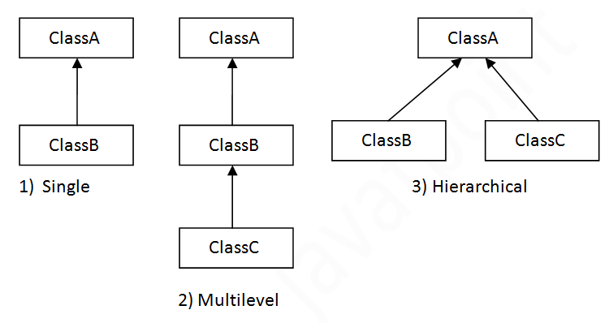
Inheritance
Types of Inheritance

Slide 9
Types of Inheritance
There is no limit to the number of subclasses a class can have
There is no limit to the depth of the class tree.
Each Java class has one (and only one) superclass.
C++ allows for multiple inheritance

Slide 10
Constructors and Initialization
Classes use constructors to initialize instance variables
When a subclass object is created, its constructor is called.
It is the responsibility of the subclass constructor to invoke the appropriate superclass constructors so that the instance variables defined in the superclass are properly initialized
Superclass constructors can be called using the "super" keyword in a manner similar to "this"
It must be the first line of code in the constructor
If a call to super is not made, the system will automatically attempt to invoke the no-argument constructor of the superclass.

Slide 11
Constructors - Example
public class BankAccount
{
private String ownersName;
private int accountNumber;
private float balance;
public BankAccount(int anAccountNumber, String aName)
{
accountNumber = anAccountNumber;
ownersName = aName;
}
[...]
}
public class OverdraftAccount extends BankAccount
{
private float overdraftLimit;
public OverdraftAccount(int anAccountNumber, String aName, float aLimit)
{
super(anAccountNumber, aName);
overdraftLimit = aLimit;
}
}

Slide 12
Method overriding - Example
public class BankAccount
{
private String ownersName;
private int accountNumber;
protected float balance;
public void deposit(float anAmount)
{
if (anAmount>0.0)
balance = balance + anAmount;
}
public void withdraw(float anAmount)
{
if ((anAmount>0.0) && (balance>anAmount))
balance = balance - anAmount;
}
public float getBalance()
{
return balance;
}
}

Slide 13
Method overriding - Example
public class OverdraftAccount extends BankAccount
{
private float limit;
public void withdraw(float anAmount) // Overriding method
{
if ((anAmount>0.0) && (getBalance()+limit>anAmount))
balance = balance - anAmount;
}
}

Slide 14
Books
1. Java Complete Reference, 7th Edition, By Herbert Schildt.
2. A Programmer's Guide to Java SE 8 Oracle Certified Associate, Khalid A. MughalRolf W. Rasmussen
3. Java How to Program Java, 9th Edition, By Deitel and Deitel.
4. The Java Language Specification, By J. Gosling, B. Joy, G. Steele, G.Bracha and A. Buckley
5. Introduction to Programming Using Java, 6th Edition, By David j. Eck
6. Head First Java, By Kathy Sierra and Bert Bates

Slide 15
References
1. 1. Java Complete Reference, 7th Edition, By Herbert Schildt.
2. A Programmer's Guide to Java SE 8 Oracle Certified Associate, Khalid A. MughalRolf W. Rasmussen
2. The Java Tutorials. http://docs.oracle.com/javase/tutorial/

